Slide 1
The Evolved Nest: The Maternal Gift Economy for All
Darcia Narvaez, PhD, University of Notre Dame, dnarvaez@nd.edu
EvolvedNest.org, KindredMedia.org
Notes:
Transdisciplinary; organizes what we know across scientific disciplines and our heritages of what human wellbeing requires and looks like.

Slide 2
1 Companionship caregiving
2 Good physio-neuro-social biology
3 Adult wellbeing and wisdom
4 Community attention to basic needs
Click here to go to film
EvolvedNest.Org

Slide 3
Meet basic needs for self-actualization to foster thriving, resilience & unique potential
Maternal Gift Economy
in action
9-Healing Practices
1-Soothing Perinatal Experiences
8-Nature Connection
2-On-Request
Breastfeeding
7-Responsive Relationships
Evolved
Nest
3-Positive, moving (no negative) touch
6-Allomothers
5-Self-Directed Social Play
4-Positive Climate
EvolvedNest.Org

Slide 4
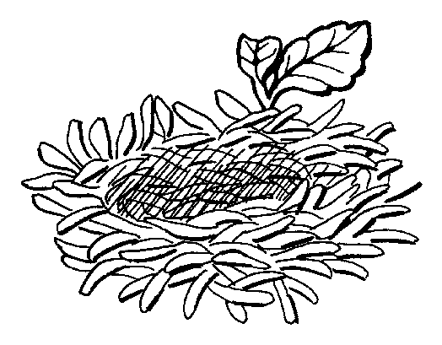
The Maternal Gift Economy Fosters the Cycle of Connected Cooperative Companionship
1- Nested companionship care from conception
2- Child self-actualization: Healthy biology, psychology & sociality
3- Adult wellbeing
& compassionate wisdom
4- Community actualization
Attends to basic needs & respectful relations
EvolvedNest.Org

Slide 5
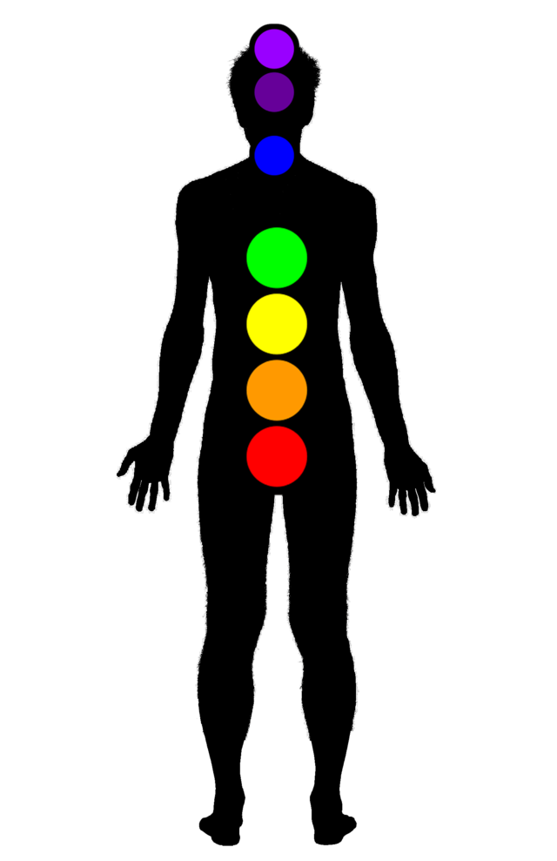
Embodied Wellness
Trust in Oneness
Spiritual Intuition
Expressive Sharing
Unconditional Love
Self-Confidence
Joyful Creativity
Self-Security

Slide 6
Thriving Self-Actualization leads to Community Self-Actualization
THRIVING INDIVIDUAL
A Quiet Mind.
Inner Happiness. Childlike glee.
Vitality.
Being Fully Alive.
Autonomy.
Honesty.
Sense of humor.
Outstanding memory and senses.
Builds habits at will.
Knowhow for getting along in the particular landscape.
Ecological attachment. Relational respect for nature.
Connection to Spirit. Has awareness of reality beyond the manifest.
THRIVING COMMUNITY
Extended self
Enjoyment being with others and enhancing their being
Relationally attuned and responsive
Empathy given and received.
Unconditional Listening.
Authentic Helpfulness.
Unconditional Love and Forgiveness.
Communal orientation.
Generosity. Sharing practiced and expected.
Egalitarian. No one coerces anyone else.
Respect for ancestors and future generations.
Responsibility toward the web of life.
J. Young; E.R. Sorenson; R.B. Lee; Narvaez
EvolvedNest.Org

Slide 7
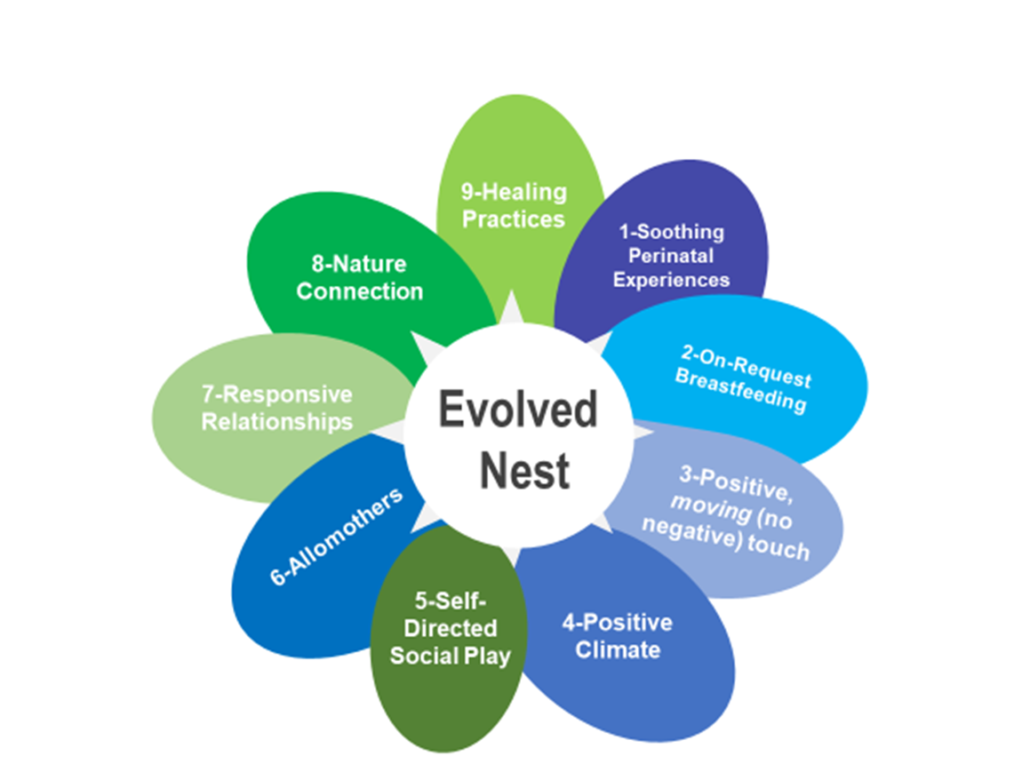
Patriarchy broke our communal Evolved Nest
Distressed babyhood
Seeds inflammation,
& dysregulation, & ill health
Physiological
Psychological
Mental
Social
Moral
Disconnected from self, others, Nature
We are colonized by coercive authoritarianism of unnestedness.
EvolvedNest.org

Slide 8
Getting stuck in Survival Systems
Self-doubt
Numbness
Insecurity
Easily triggered into fear, panic, or rage

Slide 9
Face-to-Face SELF PROTECTIONIST MINDSETS Oppositionalism (Fight) Withdrawal (Flight) Numbness (Freeze) Appease (Faint)
Early stress conditions up our innate survival systems.

Slide 10
Cycle of Competitive Detachment: The Trauma-Inducing Pathway
4 -TRAUMA-INDUCING CULTURE
Adults distracted, overwhelmed, neglectful or overcontrolling
1- UNDERCARE
Developmentally inappropriate childrearing
3- ADULT illbeing & limited socio-moral capacities
2- DYSREGULATED psychosocial neurobiology & underdeveloped capacities
Exclusionary morality:
Us vs. Them
Extreme social poverty
Plants feelings of scarcity, insecurity
Traumatized & Threat reactive
Narvaez, 2014

Slide 11
Humanity’s Wellness-Promoting Pathway
Community meets basic needs through Evolved Nest
Promotes health and thriving
Fosters heartminded individual & community, & kinship worldview
Individual & Community knowhow for compassionate regenerative lifestyle
Child wellbeing is central concern and sacred responsibility.
Maintains connectedness
Narvaez, 2014, 2016, 2018
Notes:
When we meet basic needs through the evolved nest, we start on humanity’s wellness-promoting pathway. This fosters health and thriving, develops heartminded individuals and communities who exhibit knowhow for regenerative compassionate lifestyles.

Slide 12
Nestedness or Unnestedness:? Contrasting Worldviews
“Unified, sacred and moral cosmos”
or “Fragmented, disenchanted, amoral cosmos”
Robert Redfield, The Primitive World and its Transformation
Four Arrows, Point of Departure (2016); Four Arrows & D. Narvaez , “Reclaiming our Indigenous Worldview” (2016)
Spirit pervades all things
Mutual relatedness/interdependence with All
Humans are the younger siblings
KNOWHOW CHARACTERISTICS
Relational IQ
Placefulness (at home)
Fit in with local landscape & biocommunity as partner
Share with human, non-human
Only humans have spirit
Only humans matter
Humans are the pinnacle
KNOWHOW CHARACTERISTICS
Intellectual IQ
Restlessness (“homeless”)
Dominate Nature & conform landscapes to abstract ideals
Grab/Hoard resources for (some) humans
INDIGENOUS
(our baseline)
DOMINANT CULTURE
from 17th century

Slide 13
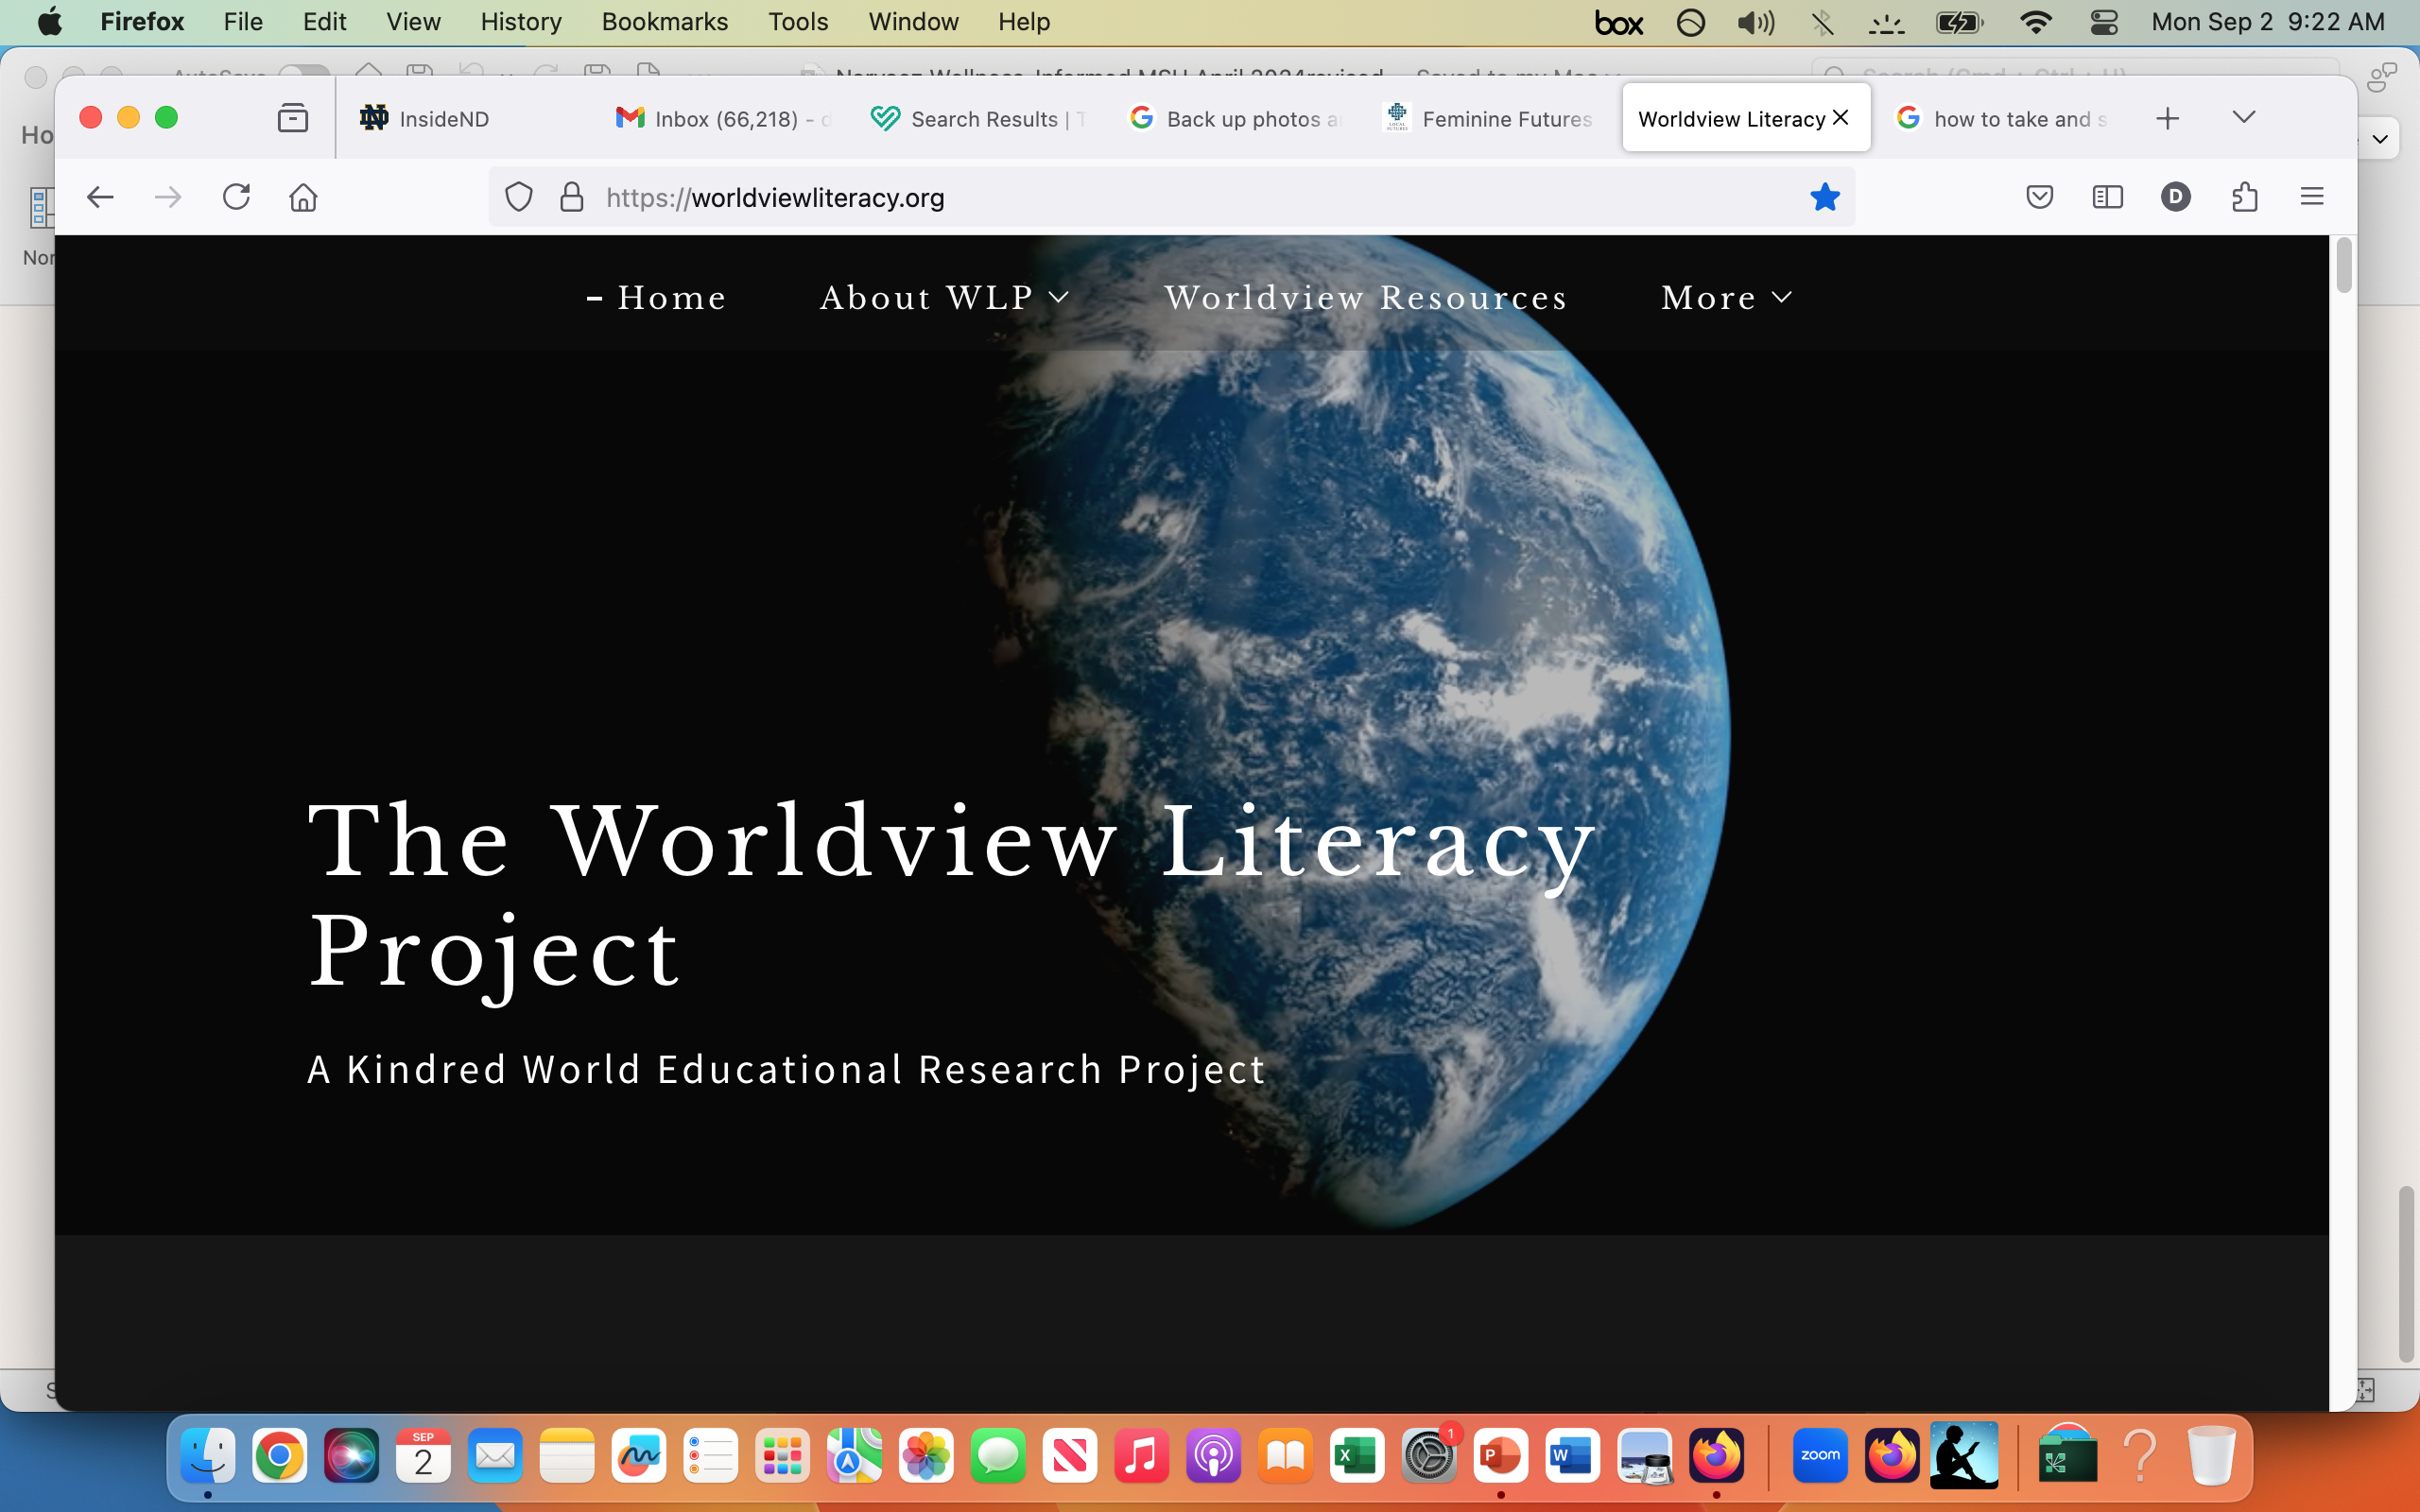
WorldviewLiteracy.org

Slide 14
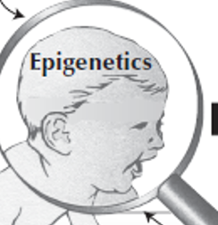
Nestedness in universe
Connection to spiritual realm
DEEP NESTEDNESS: Communal & Cosmic & Intergenerational Nestedness
Superstructure: Cultural Stories & Beliefs
Structures: Institutions & Practices
Infrastructure: Baby & Child Experience
COMMUNAL Nestedness
COSMIC Nestedness
Contemporaneous institutions and practices
Ancestral wisdom
Future generations
INTERGENERATIONAL Nestedness
Earth Nestedness
Follow the cycles of Life

Slide 15
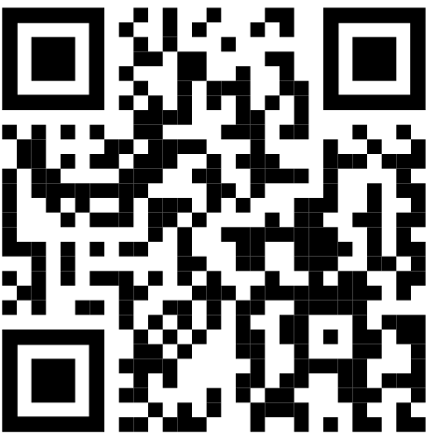
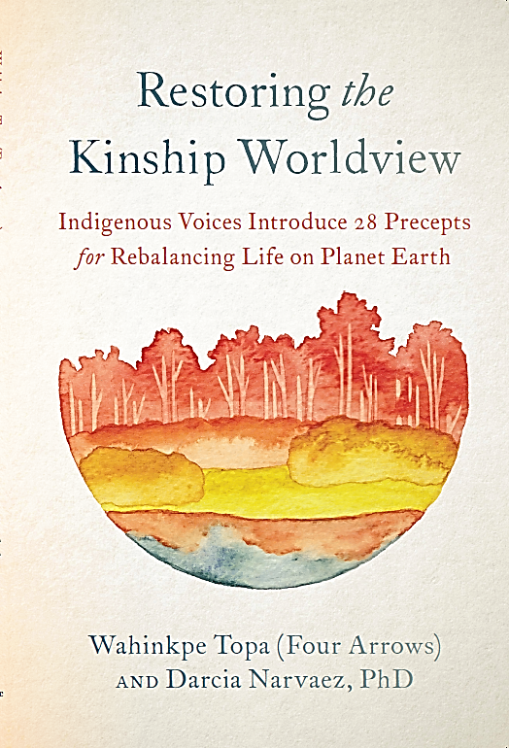
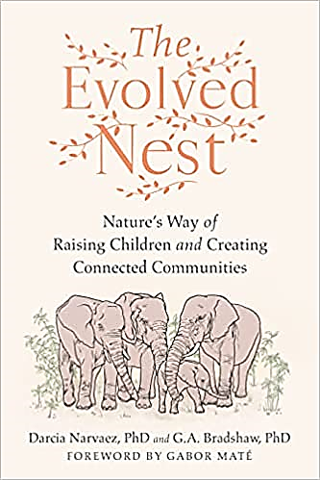
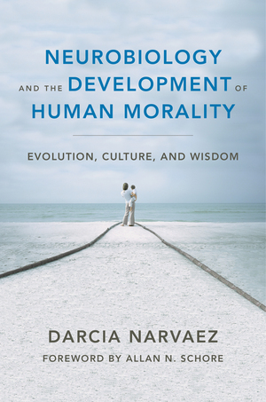
Dr. Darcia Narvaez, University of Notre Dame
Department of Psychology, dnarvaez@nd.edu
Academic Webpage
https://sites.nd.edu/darcianarvaez/
EvolvedNest.org
(podcasts, essays, videos, tools)
Click
Click
Click

